Slide 1
Quantum Cryptanalysis and Quantum Cryptography
(An Introduction)
Notes:
Quantum Computers Animated (by Piled Higher and Deeper (PHD Comics))
https://www.youtube.com/watch?v=T2DXrs0OpHU

Slide 2
Quantum Computation
From a physical point of view, a bit is a two-state system.
  In a digital computer, a bit is represented by the level of voltage.
Quantum mechanics tells us that if a bit can exist in either of two distinguishable states, it can also exist in coherent superpositions of them.

Slide 3
Experiment:
Detector A
(50% chance)
Detector B
(50% chance)
Light Source
Beam splitter
A half-silvered mirror reflects half the light that impinges on it.
Now we lower the intensity of the light source, until a single photon is emitted at a time.
  A single photon is the smallest unit. It doesn’t split.
  The probability that the photon goes to detector A is ½.
  The probability that the photon goes to detector B is also ½.
Intuitively, it seems to us that the photon leaves the beam splitter in either horizontal or vertical direction.

Slide 4
Nevertheless, the following experiment shows that this is not true. Instead, the photon takes both paths at once!
In this experiment, we carefully adjust the lengths of the paths, so that all the light will go to detector A due to interference at the upper right beam splitter.
Experiment:
Detector A
(Light)
Mirror
Detector B
(No Light)
Beam splitter
Light Source
Mirror
Beam splitter

Slide 5
After that, we lower the intensity of the light source until a single photon is emitted at a time. Due to the setting:
  The probability that the photon goes to Detector A is 1.
  The probability that the photon goes to Detector B is 0.
In this case, there are only two possible paths: Path 1 and Path 2
Intuitively, we can make the following assumption:
  Either Path 1 or Path 2 is travelled by the photon
Experiment:
Detector A
(100% chance)
Mirror
Detector B
(0% chance)
Beam splitter
Path 1
Path 2
Light Source
Mirror
Beam splitter

Slide 6
In this case, we expect that if Path 2 is blocked by a photon absorbing screen, the photon will either:
  strike A (if Path 1 is taken), or
  strike neither A nor B (if Path 2 is taken)
Expectation:
Detector A
(50% chance)
Mirror
Detector B
(0% chance)
Beam splitter
Path 1
Path 2
Light Source
Mirror
Beam splitter
Absorbing Screen
(50% chance)

Slide 7
But when we conduct the experiment, surprisingly, we found that the proton strikes both A and B with equal probability
  When the photon strikes the lower left beam splitter:
    It will take the vertical path with the probability of ½
    It will strike the absorbing screen with the probability of ½
  When the photon strikes the upper right beam splitter:
    It will go to Detector A with probability of ½ (overall: ¼)
    It will go to Detector B with probability of ½ (overall: ¼)
Experiment:
Detector A
(25% chance)
Mirror
Detector B
(25% chance)
Beam splitter
Light Source
Mirror
Beam splitter
Absorbing Screen
(50% chance)

Slide 8
An inescapable conclusion is that our assumption (traveling either Path 1 or Path 2) was wrong. Hence, the photon must, in some sense, has traveled both paths at once.
  If only one of the path opened, both A and B will illuminate
  If both paths open, only A will illuminate
    The photon somehow receives information that prevents it from reaching B and it will only reach A
  In other words, observing the photon will change the result
    If we don’t observe the photon (by using the absorbing screen), only A can receive the photon as the photon takes both path simultaneously.
    If we observe which path is travelled by the photon, both A and B are possible to receive the photon.

Slide 9
This property of quantum interference applies not only to photons but to all particles.
Someone explain this phenomena by “parallel universes”.

Slide 10
Classical Probability
  Toss two coins → 4 outcomes
    Odd: HT, TH
    Even: HH, TT
  Principle of Indifference (insufficient reason)
    P(HT) =P(TH) = P(HH) = P(TT) = ¼.
  Baye’s Sum Rule
    HT & TH are indistinguishable
    P(Odd) = P(HT) + P(TH) = ½
    P(Even) = P(HH) + P(TT) = ½

Slide 11
Detector A
Mirror
Detector B
Impinging a photon on a beam splitter is similar to tossing a coin
The aforesaid experiment is similar to tossing a coin twice
But the classical probability cannot explain why the experiment result is different from what we expected.
We need a new mathematics to explain this phenomenon.
Beam splitter
Light Source
Mirror
Beam splitter

Slide 12
Probability Amplitude
  The probability is the absolute square of the probability amplitude.
    Probability amplitudes are complex numbers.
    Replaces Principle of Indifference
  Feynman’s Sum rule (instead of Bayes’s Sum rule)
    When an event can occur in several alternative ways, the probability amplitude for the event is the sum of the probability amplitude for each way considered separately.
      Interference may occur.
    If an observation is performed and is capable of determining whether one or another alternative is actually taken, the probability of the event is the sum of the probability of each alternative.
      The interference is lost.

Slide 13
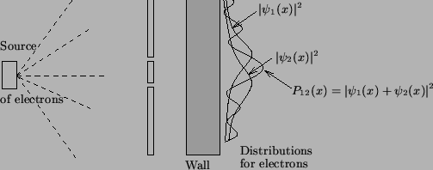
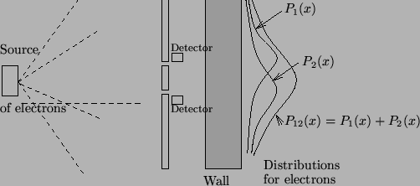
Source of the pictures: http://questions.science.nus.edu.sg/Book/node8.html
Probability amplitude can also be used to model the double slit experiment: Normally, interference pattern appears at the wall. But if detectors are placed to observe which slit the photon has passed through, the interference pattern will disappear.
Notes:
Dr Quantum - Double Slit Experiment
https://www.youtube.com/watch?v=DfPeprQ7oGcfPeprQ7oGc

Slide 14
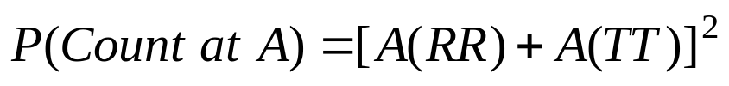
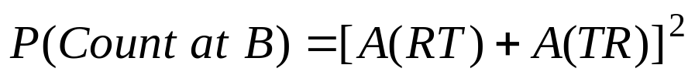
Count at Detector A
  Two reflections (RR) and two transmission (TT), indistinguishable.
Count at Detector B
  RT & TR, indistinguishable.
Detector A
mirror
Detector B
Beam splitter
Light Source
mirror
Beam splitter

Slide 15
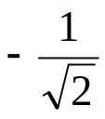

How to assign the probability amplitudes?
  Two cases for input.
  Two cases for output.
  Detection probabilities are equal.
When the following four values are assigned, the calculations will match with the experiment result
input
input

Slide 16
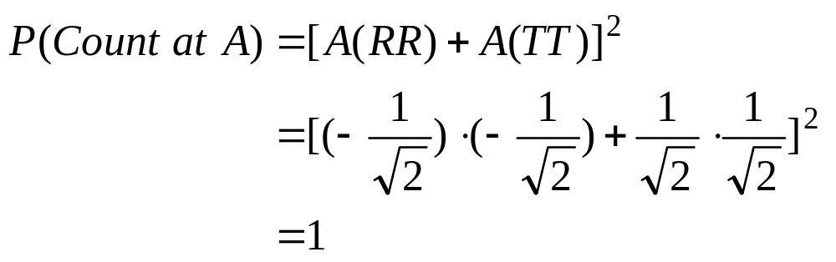
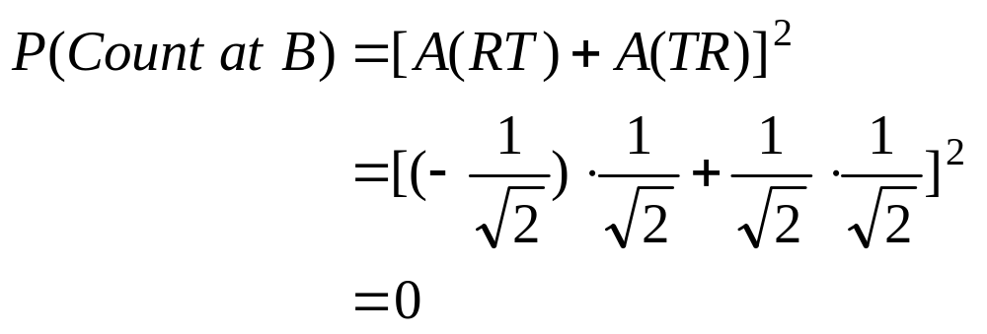
Detector A (100% chance)
Detector B (0% chance)
Light Source

Slide 17
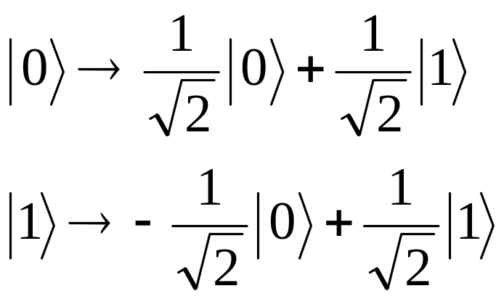
Represent the direction by state
  State 0 : vertical
  State 1 : horizontal
After passing through a beam splitter, the state of a photon is a superposition of both 0 and 1.

Slide 18
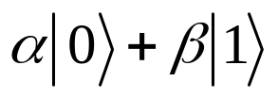
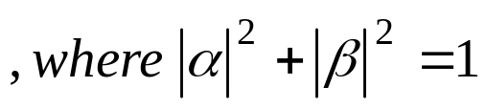
Just as the photon can be in a coherent superposition of being on the path H and the path V, any quantum bit, or qubit, can be prepared in a superposition of its two logical states 0 and 1.
That means a qubit can store both 0 and 1 simultaneously.
In general a qubit can be written as a superposition

Slide 19
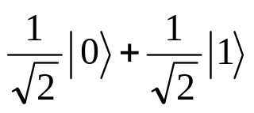
But note that just as the photon, if measured, will be detected on only one of the two paths
Hence, if the qubit is measured, only one of the two numbers it holds will be detected, at random
The probability of the measured state is proportional to the magnitude of the state.
  If the probabilities of states 0 and 1 are the same, we have

Slide 20
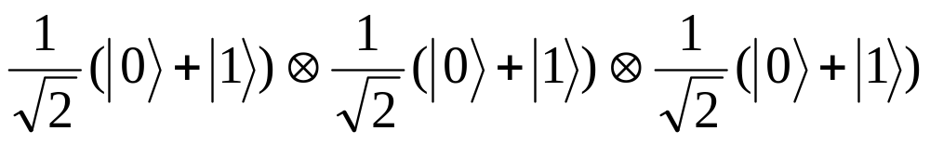
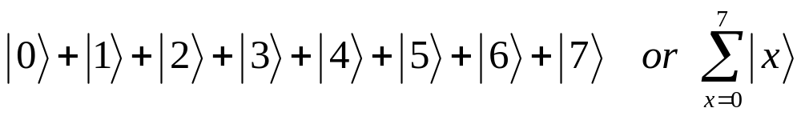
A classical 3-bit register can store eight different numbers: 000, 001 ,….., 111.
A quantum register composed of three qubits can simultaneously store up to eight numbers in a quantum superposition.
It can also be written as (ignoring the normalization constant).
Or in decimal notation

Slide 21

In general, L qubits can store up to numbers at once.
If a register is prepared in a superposition of many different numbers, we can perform mathematical operations on all of them at once.
Quantum logic gate is a device which performs a fixed unitary operation on qubits.

Slide 22
The most common gate is Hadamard gate.
  Correspond to the action of a beam splitter.
  Prepare a qubit
Two Hadamard gates form a Not gate.
There are many other quantum logic gates.
The computation is reversible.
  Output state is entangled with the input state
Notes:
Classical XOR gate is irreversible
0 XOR 0 → 0
0 XOR 1 → 1
1 XOR 0 → 1
1 XOR 1 → 0
Given the output 0, we cannot determine the two inputs are 0s or 1s.

Slide 23
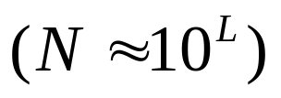

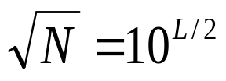
Quantum Factoring
RSA depends on the difficulty of factoring, which grows rapidly with the size (traditional method)
  Take N with L digits.
  Divide it by 2, 3, …, floor( ), and check whether the remainders are zero.
  Approximately divisions are required .
  Suppose a computer is capable of performing 10¹² divisions per second
  It take about 10³⁸ seconds to factor a 100-digit number.
Notes:
N = pq

Slide 24
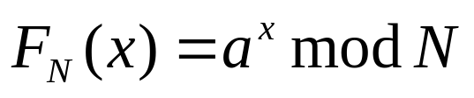

Mathematics of factoring
  Quantum factoring of an integer N is based on calculating the period of the function
    Choose a random number a between 0 and N, then raise it to the power x, divide by N, and keep the remainder.
    It turns out that for increasing powers of a, the remainders form a repeating sequence with a period r.
    Once r is known, the factors of N are obtained by calculating the greatest common divisor of N and
    Greatest common divisors can be found effectively by Euclidean algorithm (known since 300BC)

Slide 25
Shor’s Algorithm
Pick a pseudo-random number a < N
Compute gcd(a, N). This may be done using the Euclidean algorithm.
If gcd(a, N) ≠ 1, then there is a nontrivial factor of N, so we are done.
Otherwise, use the quantum period-finding subroutine to find r, the period of the following function:
F_{N}(x) = a^{x} mod N
i.e. the smallest integer r for which F_{N} (x + r) = F_{N} (x).
If r is odd, go back to step 1.
If a^{r/2} ≡ -1 (mod N), go back to step 1.
The factors of N are gcd(a^{r/2} + 1, N) and gcd(a^{r/2} - 1, N).
Notes:
N = 21, a = 15 → gcd(21,15) = 3

Slide 26
  Example
    Suppose we want to factorize 15.
    Chose a = 11.
    Increasing x the function 11^{x} mod 15 forms a repeating sequence 1, 11, 1, 11, 1, 11….
    The period r = 2.
    Since r is not odd and 11 ≠ -1 (mod 15)
    Then we take the greatest common divisor of
      15 and 11^{2/2} - 1
        gcd(15,10) = 5
      15 and 11^{2/2} + 1
        gcd(15,12) = 3
Notes:
Shor’s Algorithm
Pick a pseudo-random number a < N
Compute gcd(a, N). This may be done using the Euclidean algorithm.
If gcd(a, N) ≠ 1, then there is a nontrivial factor of N, so we are done.
Otherwise, use the quantum period-finding subroutine to find r, the period of the following function:
F_{N}(x) = a^{x} mod N
i.e. the smallest integer r for which F_{N} (x + r) = F_{N} (x).
If r is odd, go back to step 1.
If a^{r/2} ≡ -1 (mod N), go back to step 1.
The factors of N are gcd(a^{r/2} + 1, N) and gcd(a^{r/2} - 1, N).

Slide 27
Quantum computers can find r in time which grows only as quadratic function of number of digits in N.
Consider two quantum registers, each composed of a certain number of qubits.
Take the first register and place it in a quantum superposition of all the possible integer numbers.
Then we perform an arithmetical operation that takes advantage of quantum parallelism.

Slide 28
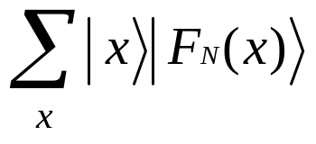
Computing the function F_{N}(x) for each number x in the superposition.
The values of F_{N}(x) are placed in the second register so that after the computation the two registers become entangled:
Now we perform a measurement on the second register.
The measurement yields a randomly selected value F_{N}(k) for some k.
Notes:
11^{x} mod 15 forms a repeating sequence 1, 11, 1, 11, 1, 11….
k = 1 → F_{N}(k) = 11
k = 3 → F_{N}(k) = 11
k = 5 → F_{N}(k) = 11
k = 7 → F_{N}(k) = 11

Slide 29
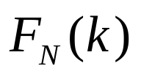
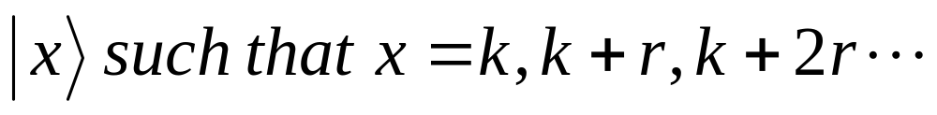
Due to the periodicity of , the state of the 1st register right after the measurement is a coherent superposition of all states
The state of the first register is subsequently transformed via a unitary operation, referred to as quantum Fourier transform.
The first register is then for the final measurement that yields a multiple of 1/r.
From this result r and subsequently factors of N can be easily calculated.
Notes:
11^{x} mod 15 forms a repeating sequence 1, 11, 1, 11, 1, 11….
k = 1 → F_{N}(k) = 11
k = 3 → F_{N}(k) = 11
k = 5 → F_{N}(k) = 11
k = 7 → F_{N}(k) = 11

Slide 30
An open question has been whether it would ever be practical to build physical devices to perform such computations.
Some experimental results have been announced.
  The numbers 15 and 21 were successfully factorized by quantum computers using the Shor’s algorithm.
Other algorithms have been developed and the largest number factored by a quantum device nowadays is 56,153
  The minimization algorithm
  4 qubits

Slide 31
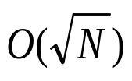
Suppose a practical quantum computer is built
  RSA will be broken
    Rely on the difficulty of factoring large numbers
  Diffie-Hellman Key Exchange will be broken
    Rely on the difficulty of computing discrete logarithm
  Symmetric key algorithms (e.g., AES) and secure hash functions (e.g., SHA-2, SHA-3) will be weakened, but still usable, say, by doubling the key size
    Given a function with domain size N, a quantum computer can apply Grover's algorithm and use operations to find with high probability the unique input to a function that produces a particular output value.
    For AES with 128-bit key
      Brute force attacks using traditional computers require 2¹²⁸ operations
      Brute force attacks using quantum computers require 2⁶⁴ quantum operations

Slide 32
Quantum Cryptography
Classical cryptography employs various mathematical techniques to restrict eavesdroppers from learning the contents of encrypted messages.
In quantum mechanics, the information is protected by the laws of physics.
The Heisenberg Uncertainty Principle and Quantum Entanglement can be exploited in a system of secure communication.
  Often referred to as Quantum Cryptography.

Slide 33
There are at least three main types of quantum cryptosystems for the key distribution.
  Cryptosystems with encoding based on two non-commuting observables proposed by S.Wiesner (1970), and by C.H.Bennett and G.Brassard (1984).
  Cryptosystems with encoding built upon quantum entanglement and the Bell theorem proposed by A.K.Ekert (1990).
  Cryptosystems with encoding based on two non-orthogonal state vectors proposed by C.H.Bennett (1992).
We will give a brief overview of types A and B

Slide 34
Quantum Cryptosystem (A)
  The system includes a transmitter and a receiver.
  A sender may use the transmitter to send photons in one of the four polarizations:
    0, 45, 90, 135.
  A recipient at the other end uses the receiver to measure the polarization.
  According to the laws of quantum mechanics, the receiver can distinguish between rectilinear polarization (0 and 90), or it can quickly be reconfigured to distinguish between diagonal polarizations (45 and 135).

Slide 35
  When rectilinear measurement is used (i.e. placing a photon detector behind a polarized len of 0 degree)
    Photons with polarization of 0 degree can pass through.
    Photons with polarization of 90 degree cannot pass through
    Whether photons with polarization of 45 or 135 degree can pass through are random.
  Similarly, when diagonal measurement is used (i.e. placing a photon detector behind a polarized len of 45 degree)
    Photons with polarization of 45 degree can pass through.
    Photons with polarization of 135 degree cannot pass through
    Whether photons with polarization of 0 or 90 degree can pass through are random.

Slide 36
  The sender sends photons with one of the four polarizations that is chosen at random.
  For each incoming photon, the receiver chooses at random the type of measurement.
    Either the rectilinear type or the diagonal type.
  The receiver records the results of the measurements (whether the photon passes through the filter), but keeps them secret.

Slide 37
  Subsequently the receiver publicly announces the type of measurement (i.e., rectilinear or diagonal measurements for each incoming photon).
  The sender tells the receiver which measurements were the correct type.
  Both parties keep all cases in which the receiver measurements were of the correct type.
  These results are then translated into bits (1’s and 0’s) and thereby become the key.

Slide 38
Example
Degree 45 = 0
Degree 0 = 0
Degree 90 = 1
Degree 135 = 1
Rectilinear (R)
Diagonal (D)
Photon sent
1st | 2nd | 3rd | 4th | 5th | 6th | 7th | 8th | 9th | 10th
0 | 90 | 45 | 90 | 135 | 45 | 0 | 135 | 45 | 90
R | R | D | R | D | D | R | D | D | R
D | R | R | D | R | D | R | R | D | D
No | No | Yes | Yes | Yes | Yes | Yes | No | Yes | No
1 | 1 | 0 | 0 | 0 | 0 | 0 | 1 | 0 | 1
No | Yes | No | No | No | Yes | Yes | No | Yes | No
Polarization (degree)
Sending Type
Measurement Type (receiver)
Photon received
Values
Correct measurement
The values agreed are 1000

Slide 39
  An eavesdropper is bound to introduce errors to this transmission
    The eavesdropper has to capture the photon and the original photon cannot reach the recipient
    Hence, the eavesdropper has to reproduce the photon and transmit it to the recipient
    But the eavesdropper cannot reproduce the photon with the same state, as quantum mechanics does not allow him/her to acquire sharp values of two non-commuting observables (rectilinear and diagonal).
    In other words, if the photon is sent in rectilinear type, the eavesdropper will never know whether the photon can pass through the filter if it is measured in diagonal type, and vice versa.
  The two legitimate users can test for eavesdropping by revealing a random subset of the key bits and checking the error rate.
  They cannot prevent the eavesdropping, but it can be detected.

Slide 40
Quantum Cryptosystem B
  In quantum theory, a combined system can be said to be entangled.
    Entangled states were first investigated in the famous paper of Einstein, Podolsky, and Rosen (EPR) in 1935.
  Suppose the sender wants to transmit information to the receiver.
  The receiver first prepares two photons (or two spin-half particles that spin up or down) jointly in an entangled state.
  The receiver stores one particle and sends the other to the sender.
Notes:
A Einstein, B Podolsky, N Rosen. Can Quantum-Mechanical Description of Physical Reality be Considered Complete?. Physical Review. 47 (10): 777–780, 1935.

Slide 41
  The sender performs one of four special operation on the received particle
    For photon
      The operation corresponds to polarization rotations.
    For the spin-half particle, the operations are:
      Do nothing
      Rotate the spin by 180 degrees along x, y,or z axis.
  The operation represents the information that the sender wants to transmit.
  These operations, although performed only on one particle, affect the joint (entangled) quantum state of the two particles.

Slide 42
  This cannot be verified by measurements on the two particles separately.
  The sender then sends back the particle to the receiver, who can measure both of them jointly and determine which of the four operations the sender has performed.
  Thus the technique effectively doubles the peak capacity of an information channel.
2-bit message out
M
U
Time
EPR
source
2-bit message in
sender
receiver

Slide 43
  An eavesdropper on this communication would have to detect a particle to read the signal, and retransmit it in order for his presence to remain unknown.
  However, the act of detection of one particle of a pair destroys its quantum correlation with the other, and the two parties can easily verify whether eavesdropping has been done.

